Slide 1
Tranquil System
Companion for the journey of customer service

Slide 2




What does it Tranquil do?
Tranquil simply tells you that your service staff are working
… When they come in
… When they leave
… When they take breaks
…What they are doing

Slide 3
Objective
To create a user journey so compelling the technology is secondary

Slide 4
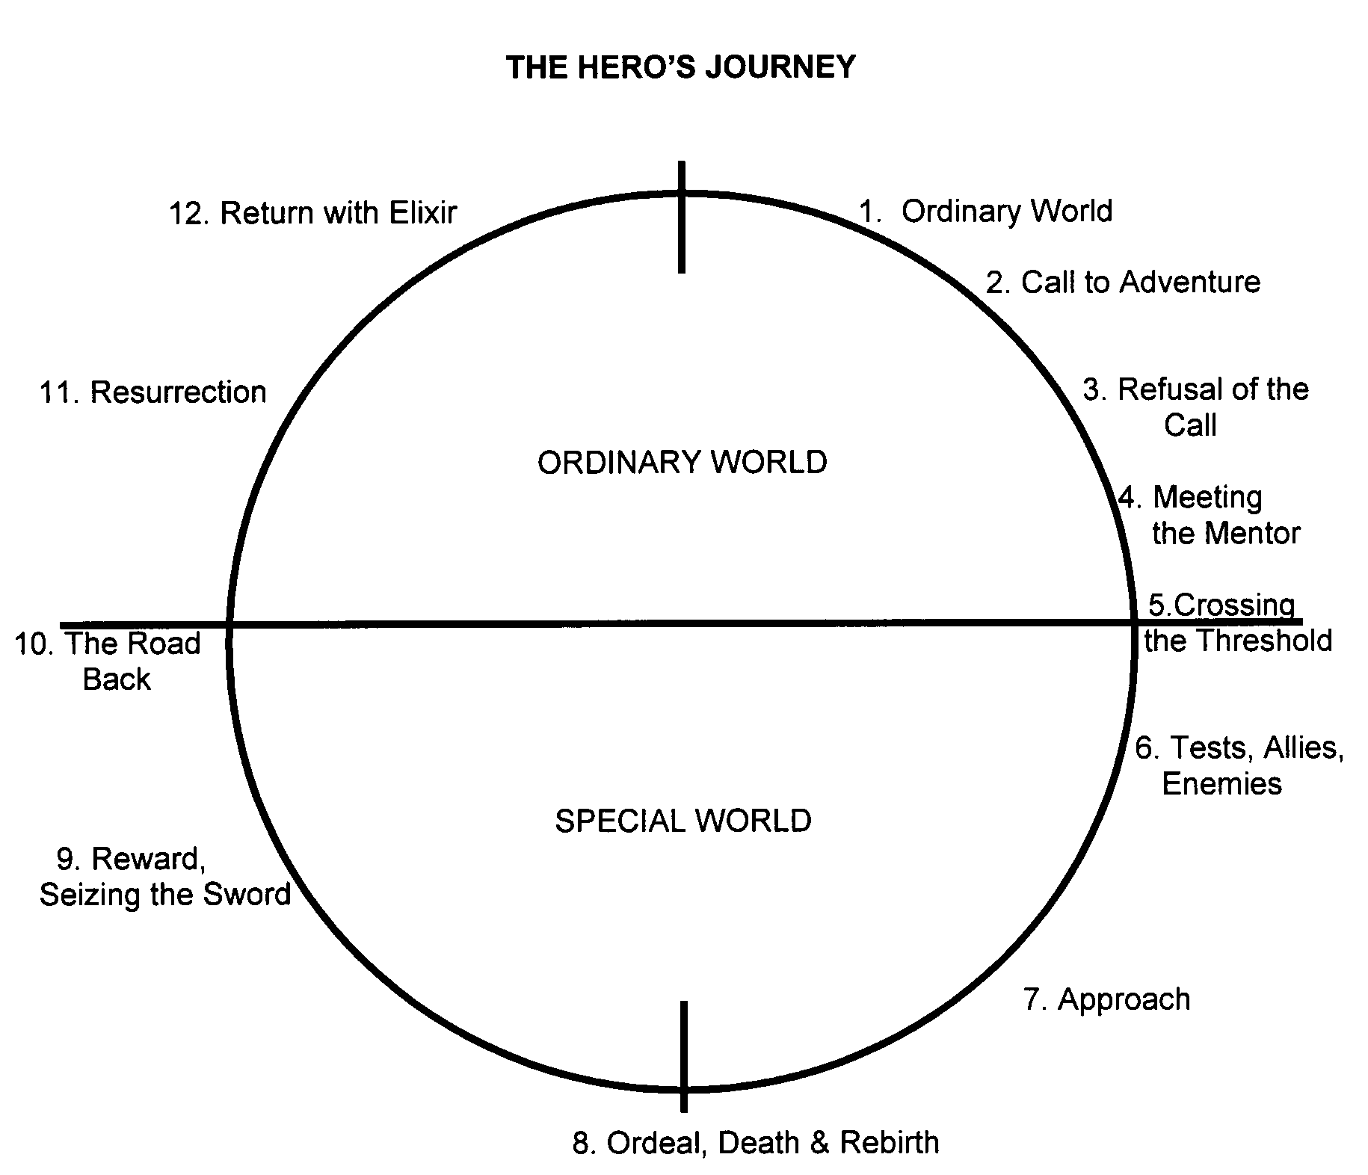
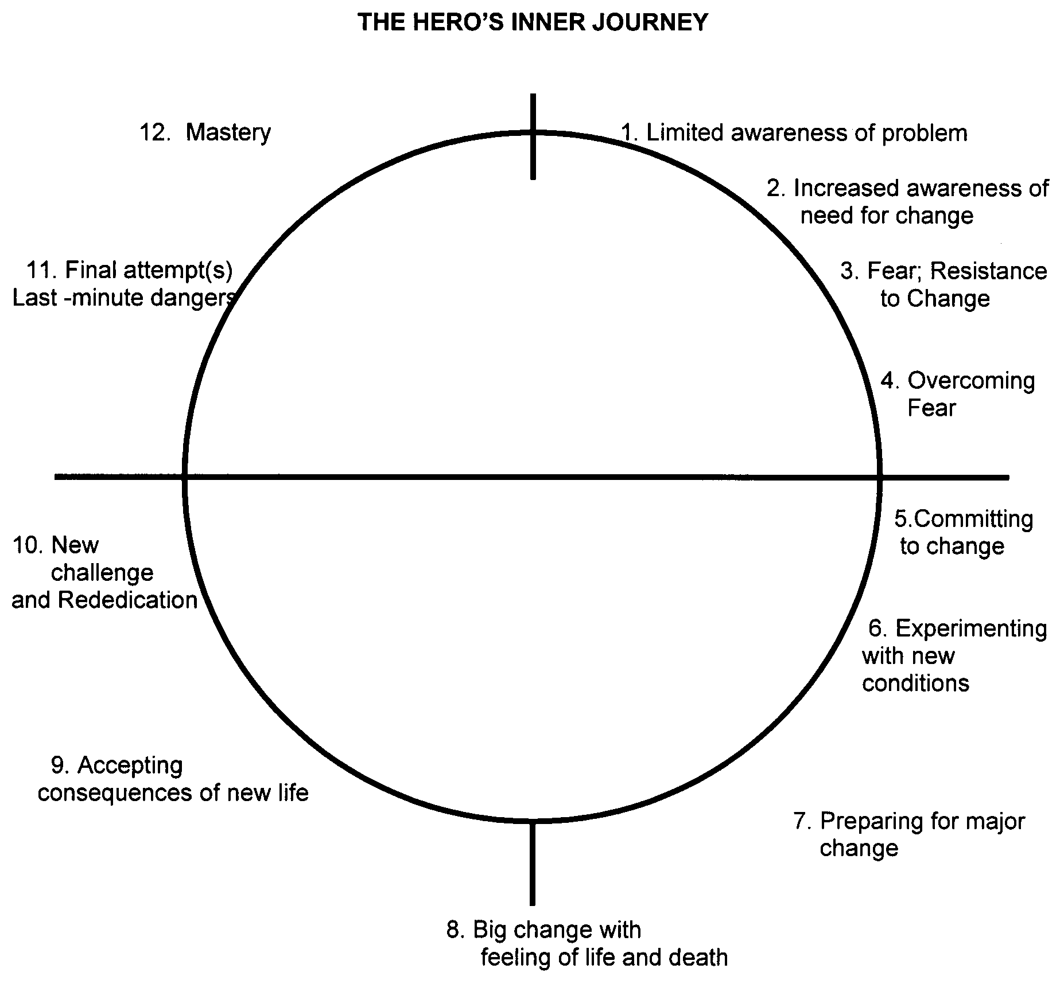
Strategy
Tranquillity leverages the monomyth to create an ongoing narrative of continuous improvement for customer service staff to lead them to the next stage of their career

Slide 5



1 Story. 3 Protagonists.
Area Manager
The Oracle
Store Manager
The Guide
Customer Service Staff
The Hero

Slide 6
The Journey
First Day on the job
The Call to Adventure
Assignment of a mentor
Supernatural Aid
Assignment of Duties
Crossing the threshold
Work / Challenges / Targets
The Road of Trials
Support groups
Atonement with the Father
Promotions
The Crossing of the Return Threshold

Slide 7


Good morning

Slide 8






What about people among us?
Veteran, PTSD, drunk, trapped
I have a house, but no home

